Slide 1

Open AGV_UI in VNC Viewer (PC) on myAGV
Be patient, it takes a while...

Slide 2
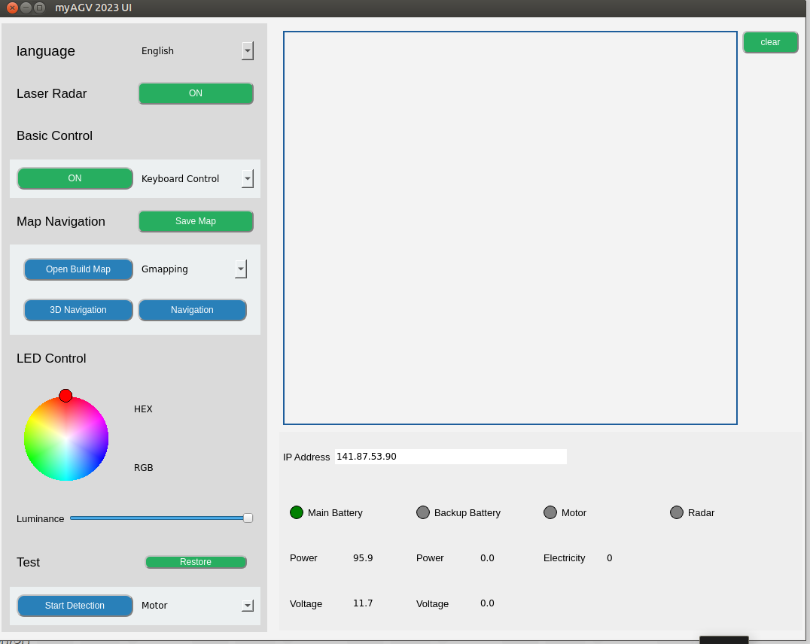
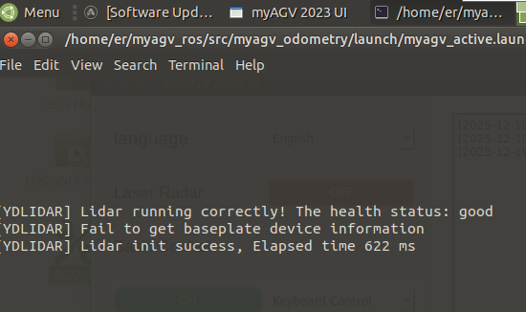
First, turn on LIDAR.
A message appears in this window: “Radar open.”
A window opens in the background from ROS, providing information about the LIDAR function. The window can be closed by clicking on the “Close” button.

Slide 3
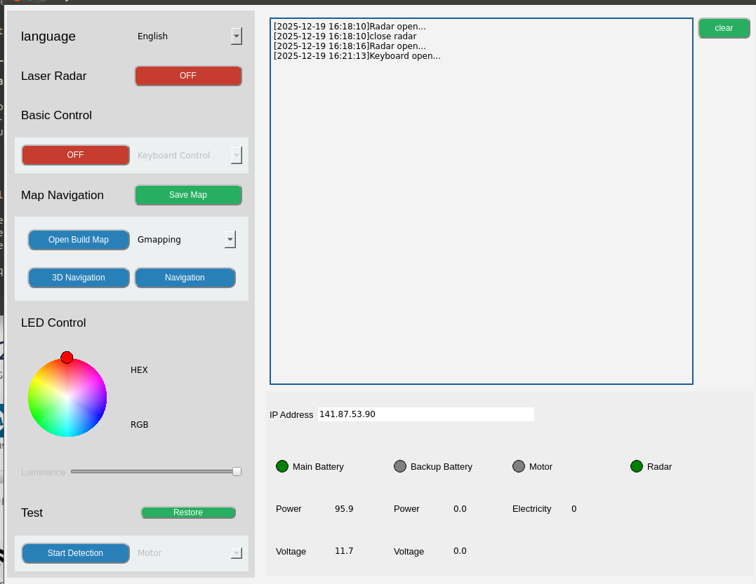
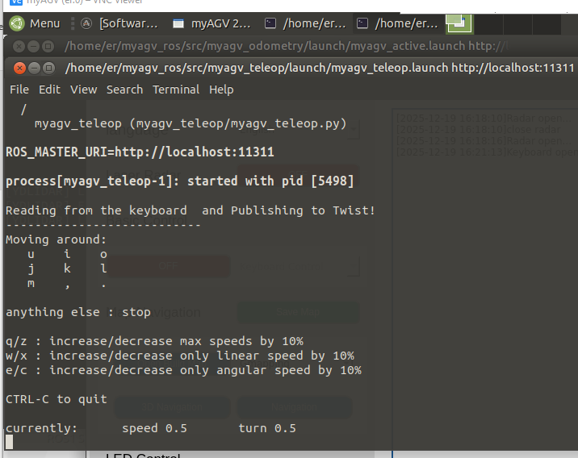
The ROS window in the background displays information on controlling the AGV (for more details, see also the GitBook).
Now switch on the control via keyboard. Press the “Start” button.

Slide 4
Use the control buttons (or alternatively, the gamepad without a keyboard) to move the myAGV slightly back and forth.
The LIDAR sensor is already recording the room.

Slide 5
Now, click on Open Build Map. RViz opens, and the already captured environment is displayed(see next slide).

Slide 6
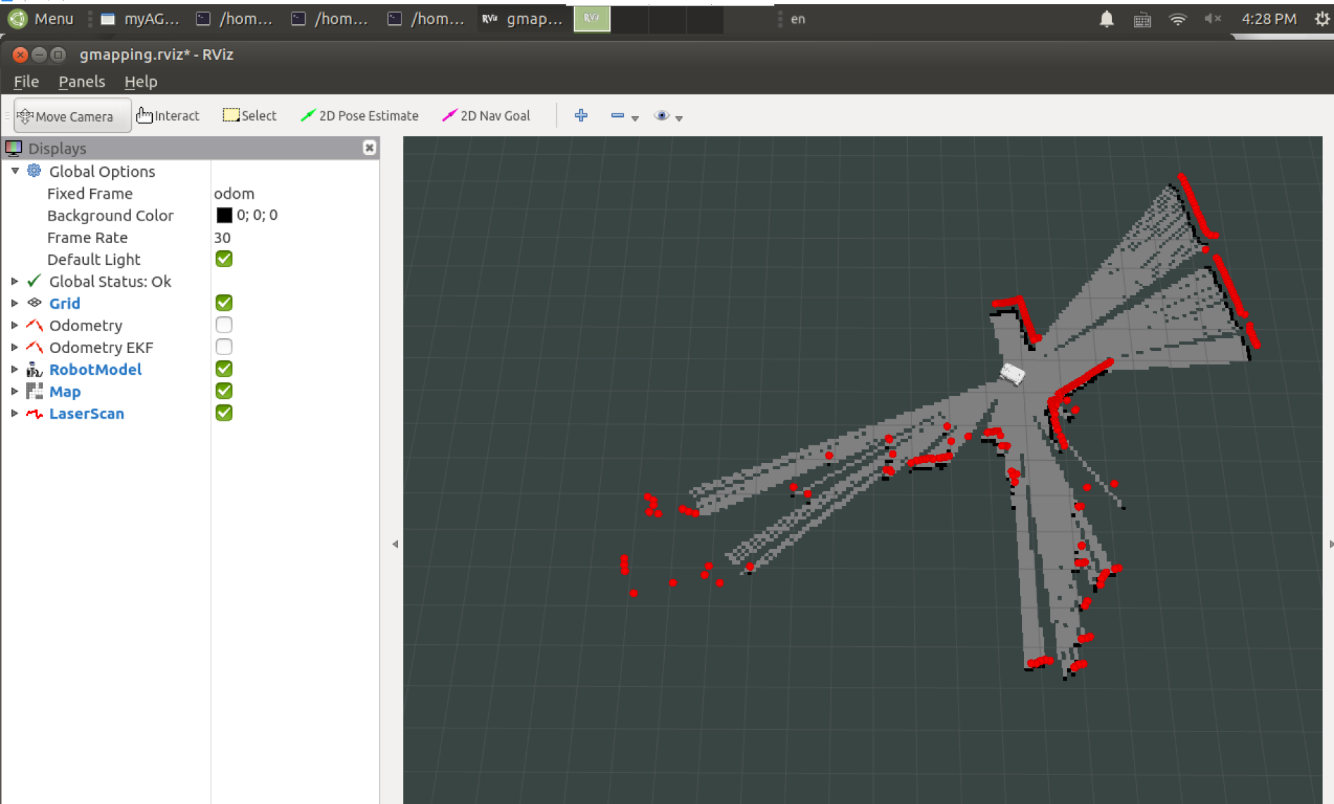

Slide 7
With 3D Navigation and Navigation, you can create maps just like before with Rviz.
Further functionality, then according to Gitbook (Prof. Dr Sommer has the documents)

